Slide 1
CSLAB – First Delivery
1210804 – André Gonçalves
1201458 – Jorge Moreira

Slide 2
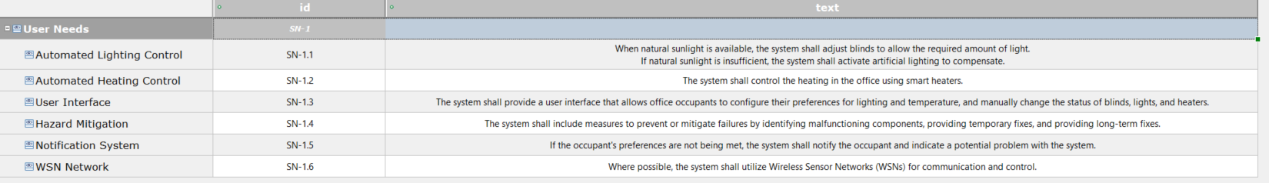
Problem Domain
Stakeholder Needs

Slide 3
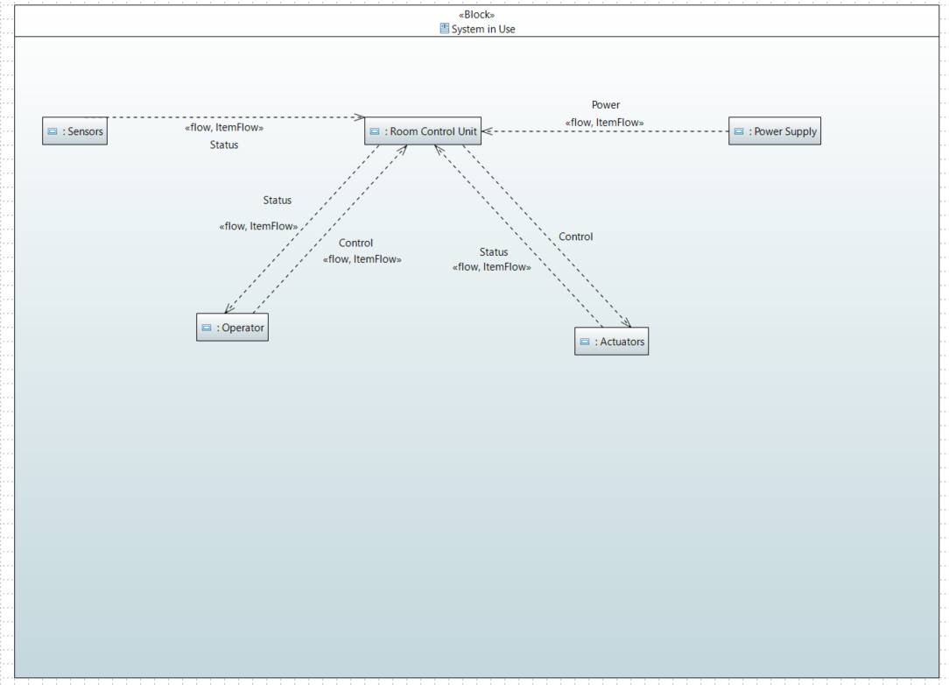
Problem Domain
System Context
Notes:
SISTEMA DE UMA SALA ACTUATORS SÃO OS LEDS E MOTOR

Slide 4
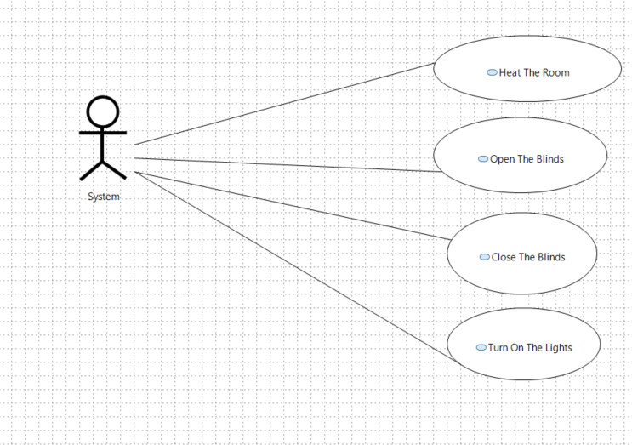
Problem Domain
Use Case

Slide 5
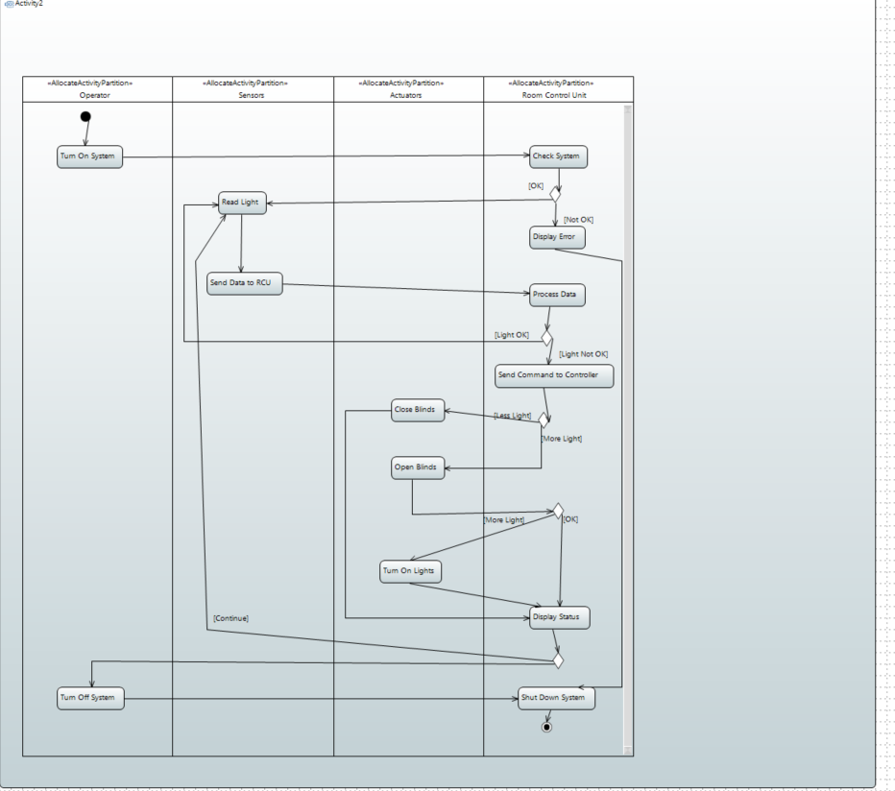
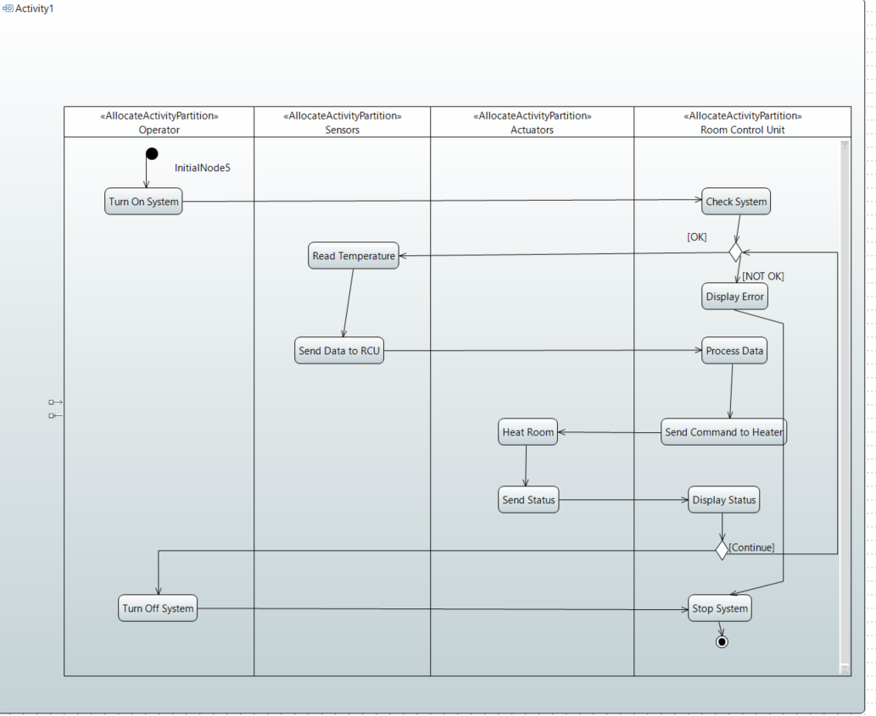
Problem Domain
Activity Diagram

Slide 6
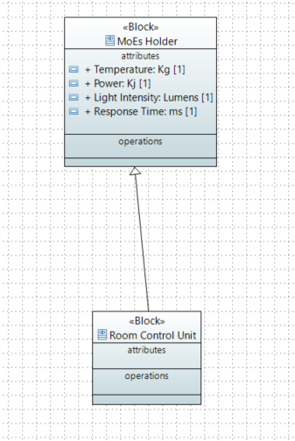
Problem Domain
Measures of Effectiveness

Slide 7
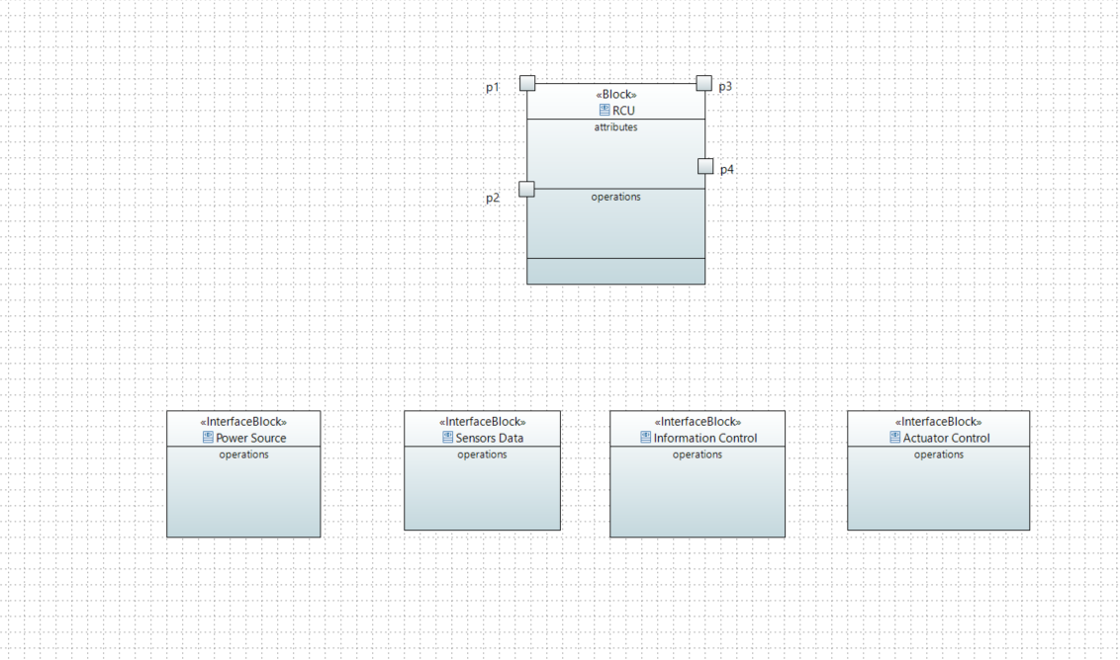
Problem Domain
Conceptual Systems

Slide 8
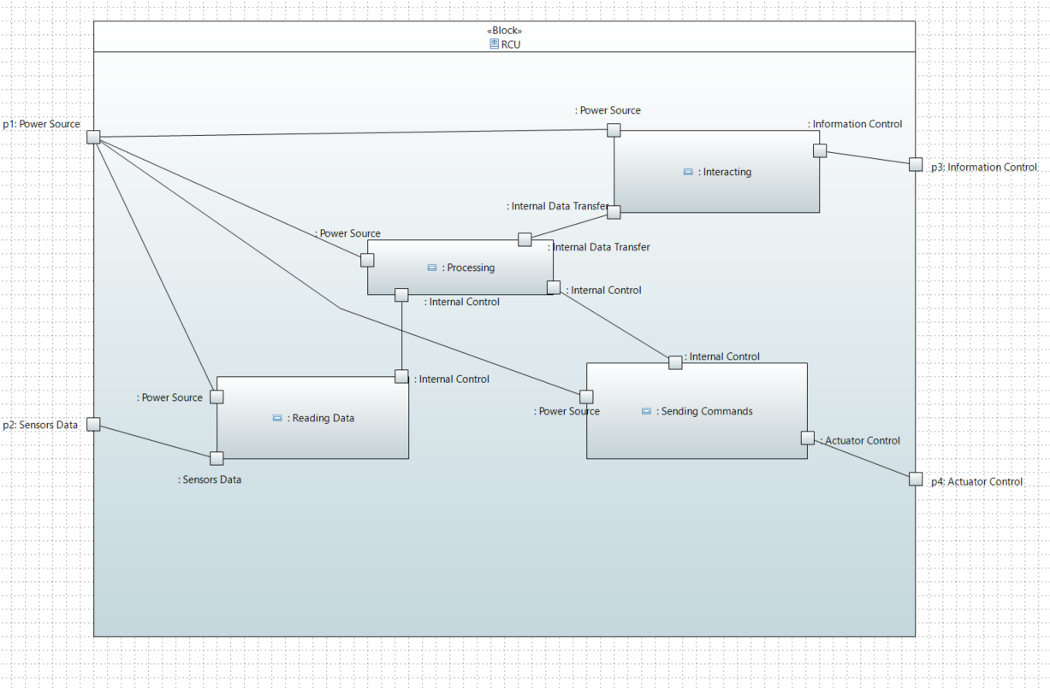
Problem Domain
Conceptual Sub Systems

Slide 9
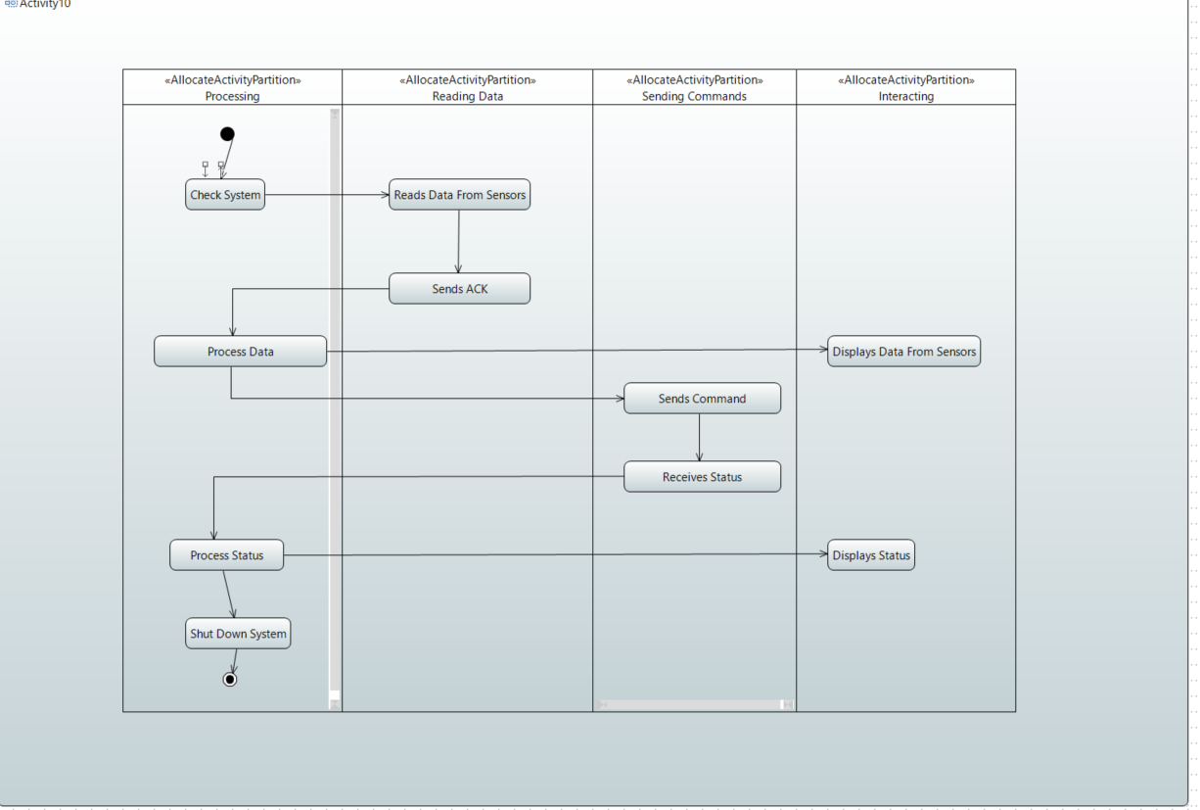
Problem Domain
Conceptual Sub systems (Activity Diagram)

Slide 10
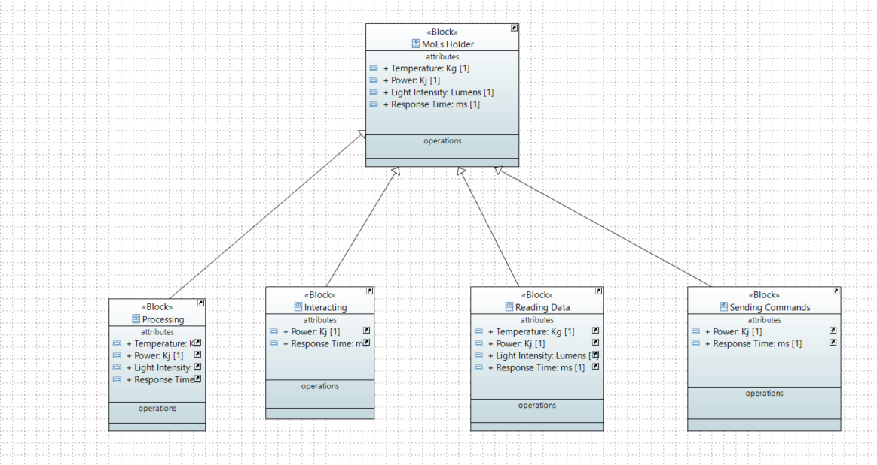
Problem Domain
Measures of effectiveness for the conceptual subsystems

Slide 11
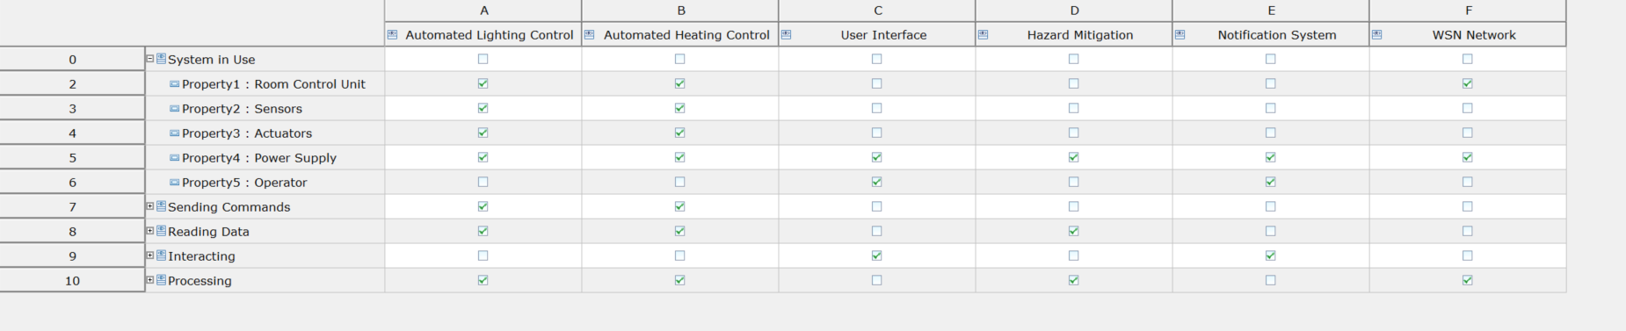
Problem Domain
Traceability

Slide 12
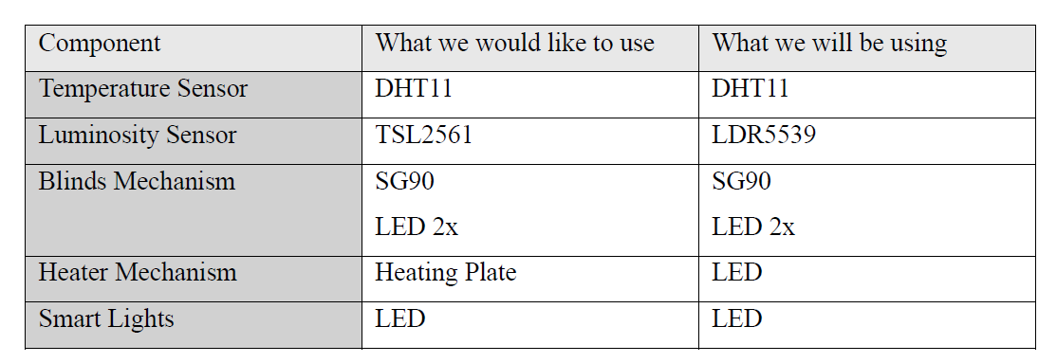
Components

Slide 13
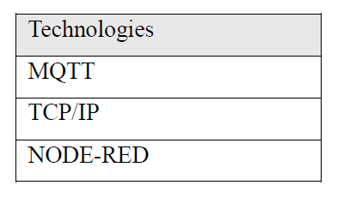
Technologies
INTERFACE
ROOM CONTROL UNIT
SENSORS
ACTUATORS

